Slide 1
A CASE STUDY PRESENTATION ON NECROTIZING FASCITIS FOLLOWING POORLY MANAGED TOOTH EXTRACTION
BY
MAMAH, CHINEMEREM PERPETUA
SUPERVISOR DTN. ONYEKWELU, CHIMDINDU CHIZITELU.
MARCH 2024

Slide 2
OVERWIEW
NECROTIZING FASCITIS
Necrotizing Fasciitis also called FLESH EATING DISEASE This is a serious bacterial infection that destroys tissue under the skin called FASCIA.
Flesh-eating disease occurs when bacteria enters the body through a break in the skin.
The skin and soft tissue becomes infected causing muscle fascia and subcutaneous tissue necrosis. The infection typically travels along the fascial plane, which has a poor blood supply.

Slide 3
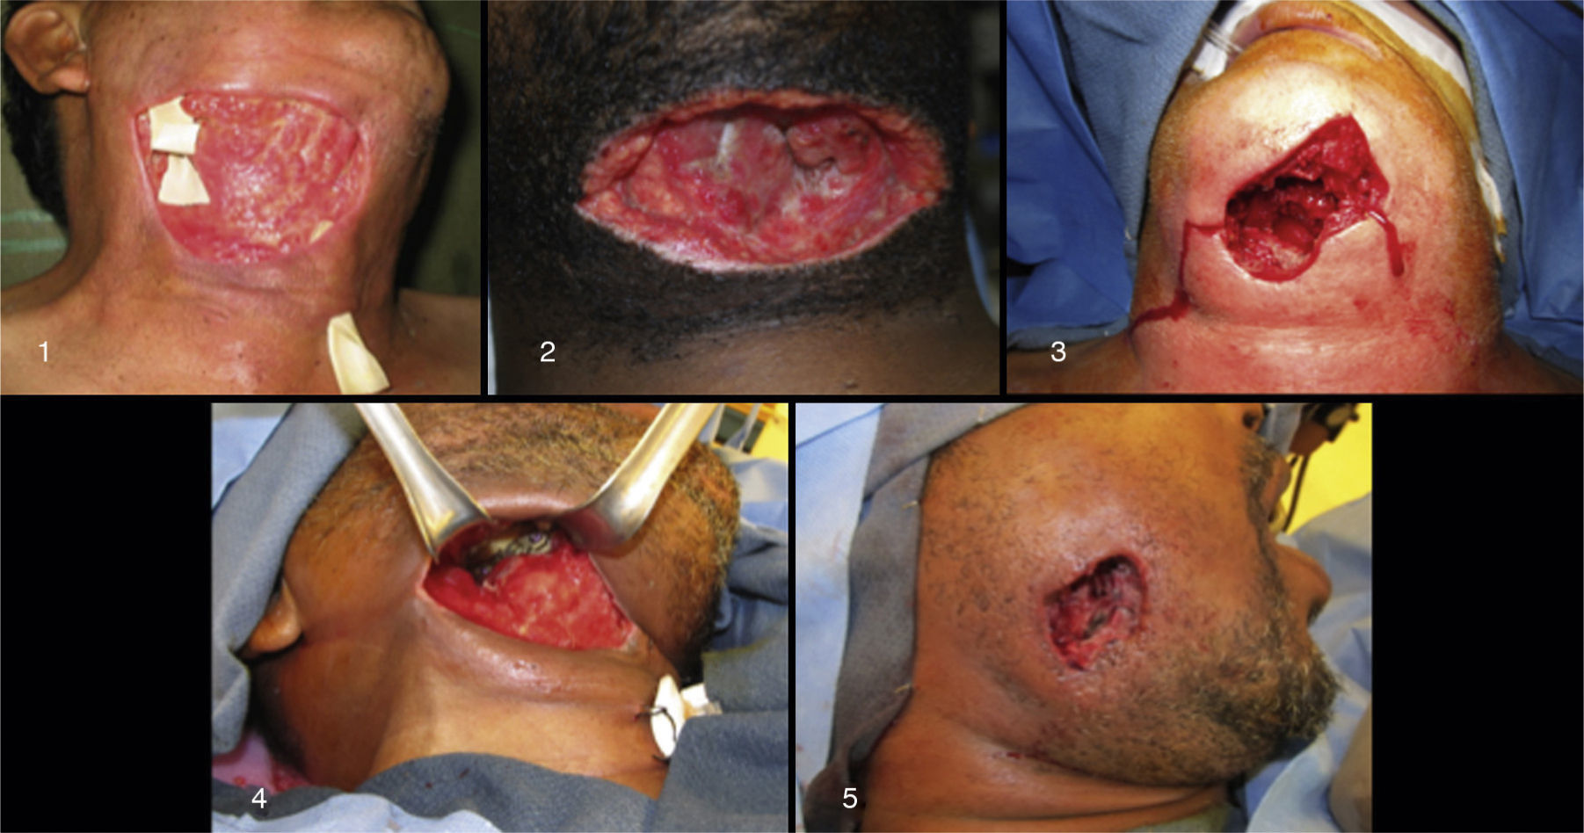
IMAGE OF A NECROTISED TISSUE

Slide 4
CAUSES OF NECROTIZING FASCITIS
Group A Streptococcus (group A strep bacteria) cause necrotizing fasciitis.
The most common way to get necrotizing fasciitis is when bacteria invades the body through a cut in the skin, although it can happen if one has a trauma that doesn't break the skin.
Ways that bacteria can enter the skin are through cuts scrapes, burns or Insect bites.

Slide 5
HOW CAN IT BE DIAGONISED?
There are many infections that look similar to necrotizing fasciitis in the early stages, which can make diagnosis difficult. In addition to looking at the injury or infection, healthcare providers can diagnose necrotizing fasciitis with:
Biopsies (taking tissue samples)
Bloodwork for signs of infection and muscle damage
Imaging (CT scan, MRI, ultrasound) of the damaged area
It is important to start treatment as soon as possible. However, healthcare providers may not need to wait for test results if they think a patient might have necrotizing fasciitis.

Slide 6
SIGNS AND SYMPTOMS OF NECROTIZING FASCITIS
Wasting
Very severe pain and redness around affected area
Area becomes dark and dusky and then turns black, and the tissue dies.
Skin may break open and ooze pus like fluid.
Flu-like symptoms, such as a high temperature, headache and tiredness.
Hypotension
In some cases, Kidney failure

Slide 7
TREATMENT OF NECROTIZING FASCITIS
Necrotizing fascitis requires intense hospital care. Antibiotics and surgery are typically necessary.
Antibiotics helps to stop the infection. Healthcare providers give antibiotics through an IV, which allows medicine to flow into the vein.
Sometimes, however, antibiotics can't reach all the infected areas because the bacteria have killed too much tissue and reduced blood flow. When this happens, dead tissues are surgically removed.

Slide 8
TREATMENT CONTINUED
Surgery
Since necrotizing fasciitis can spread rapidly, patients often times must get surgery quickly to remove dead or infected tissues.
It's not unusual for someone with necrotizing fasciitis to end up needing multiple surgeries.
In some serious cases, the patient may need a blood transfusion.

Slide 9
NUTRITIONAL MANAGEMENT OF NF
Nutritional management for necrotizing fasciitis (NF) focuses on meeting the increased energy and protein needs due to the catabolic state and large wounds.
Due to the severity of the bacterial infection, it leads to hypercatabolism, meaning the body breaks down tissues for energy. This, combined with the large open wounds, significantly increases nutritional requirements, particularly for calories and protein.

Slide 10
Early diagnosis and nutrition support is an essential component for patient’s successful outcome in NF
Patients with NF have increased energy requirement and suggests provision of calories up to 25kcal/kg of actual wt/d.
Due to surgery ,protein needs are increased to improve wound healing.
The key component is enteral feeding (tube feeding) and should be continued until adequate oral intake is achieved.

Slide 11
MEDICAL NUTRITION THERAPY

Slide 12
I hereby present a surgical case of a 68-year-old man with Necrotizing Fasciitis following a poorly managed tooth extraction.
Ward: Crowther
Medical diagnosis :Necrotizing Fasciitis following a poorly managed tooth extraction.
Date of admission: 9/11/2024
Date case commenced: 11/11/2024
Date of discharge: 19/12/2024
Informant: Patient’s Sister

Slide 13
NUTRITION ASESSMENT
Family and Social History
Patient is a 68-year-old man who hails and resides in Ndiuga Ibina in Nkanu Ohafia LGA of Abia state.
Not married
Patient is a traditionalist
He is a farmer and hunter
Lives in a single-bedroom apartment
His Source of drinking water is rainwater
Mode of fecal disposal is pit toilet

Slide 14
Past Medical History
Patient no history of surgery or transfusion.
Has no known drug allergy
Has no history of HEADS.
Present Medical History
Patient was apparently well until he started experiencing tooth ache, went for over the counter medications but didn’t get better.
He was then taken to a peripheral hospital for extraction.
Patient’s condition grew worse and was presented to this
facility for expert management.

Slide 15
Anthropometry
Patient was non-ambulatory
BROCAS formular was used to take his length
Length=1.63m
Weight= 63kg (163-100)
Estimated BMI= 23.7 Kg/m2

Slide 16
BIOCHEMICAL INVESTIGATIONS
Hematology Test
t
TEST NAME | RESULT | REFRENCE RANGES
Packed Cell Volume | 28.0 | 40-50 %

Slide 17
Nutrition focused physical findings
O/E: An ill looking man met sitting on the bed, mildly pale, mildly dehydrated, in an obvious respiratory distress, afebrile to touch (36℃) , acynosed, severely wasted, prominent rib cages, bilateral pitting Oedema up to the knee.
VITAL SIGNS
DATE | TEMP (oC) | RR (b/m) | BP (mmHg) | PR (b/m)
9/11/24 | 36 | 20 | 100/60 | 80

Slide 18
Food and Nutrition related History
Patient is a moderate eater
Has no known food allergy
Has no food dislikes
Patient consumes fruits and vegetables sparingly
Consumes confectionaries and fizzy drinks
Takes herbal concoctions
Consumes spirits

Slide 19
24 HOURS DIETARY RECALL
MENU | FOOD ITEM | QTY (g) (Estimated) | KCAL | CHO (g) | CHON (g) | FAT (g)
BREAK FAST | PAP | 100 | 51 | 8.8 | 1.1 | 1.0
LUNCH | AGIDI | 300 | 280.02 | 59.25 | 5.52 | 1.47
DINNER | AGIDI | 200 | 280.02 | 59.25 | 5.52 | 1.47
TOTAL |  |  | 611.4 | 127.3 | 12.14 | 3.94

Slide 20
NUTRITION DIAGNOSIS
Increased protein and energy needs RT hyper catabolism AEB severe wasting, prominent rib cages and bilateral pitting Oedema

Slide 21
NUTRITION INTERVENTION
Goals of MNT
To provide adequate support for patient’s medical condition.
To provide adequate nutrition to improve wound healing
To improve quality of life and decrease overall mortality associated with the illness

Slide 22
NUTRITION INTERVENTION CONT’D
Diet prescription
Patient was placed on a HCAL HP diet of 2,800 Kcal/day
The dietary reference intake permits wide acceptable macronutrient distribution ranges. They allow, for example, 45% to 65 of calories from carbohydrate, 10-35% of calories from protein and 20 to 35% of calories from fat.

Slide 23
Calorie distribution of a day sample menu based on 2800Kcal diet
CHO: 50% of 2800kcal = 1400 kcal
1400 / 4 = 350g
Protein: 30% of 2800kcal = 840kcal
840 / 4 = 210g
Fat: 20% of 2800kcal = 560kcal
560 / 9 = 62.2g

Slide 24
A DAY SAMPLE MENU FOR FULL STRENGHT FEED
Based on 2800 kcal /day
Volume: 2000mls
Calorie: 2800 kcal
Protein: 210g
INGREDIENTS | QUANTITY (mls) | ENERGY(KCAL) | CHO (g) | CHON (g) | FAT (g)
Pap | 1600 | 1278 | 315.9 | 1.44 | -
Adult Peak | 18 | 918 | 61.74 | 48.6 | 32.4
Egg (2) | 100g | 148 | 0.92 | 12.6 | 12
Groundnut | 60 | 344.4 | 10.44 | 13.44 | 26.52
Vit C & B.co | 4 tablets
Total |  | 2,688.4 | 388.1 | 85.48 | 70.92

Slide 25
NUTRITION COUNSELLING
Patient was counselled to
Choose carbohydrate sources from complex carbohydrates such as whole grains e.g. Oat, rice, corn, garri.
Increase fiber intake through the consumption of fruits and vegetables .
Take foods rich in omega 3 fatty acids like nuts, fish, flax seeds, avocados.
To avoid consuming herbal concoctions, fizzy drinks and confectionaries.
to avoid artificial spices and to stop adding salt to table.
To maintain optimum hygiene .

Slide 26
DRUG-NUTRIENT INTERACTION
Drugs | Dosage | Functions | Drug and Nutrient interaction
IV Furosemide (60mg) | 12 hourly | Used for edema reduction. It inhibits electrolyte reabsorption from the kidneys and enhance the excretion of water from the body | Increases the absorption of ibuprofen and may decrease Serum potassium
IV Ceftriaxone (1g) | 12 hourly | Used to treat a wide variety of bacteria infections | No known interaction
Tab Vitamin C (500mg) | 2x daily | Helps to protect cells and keep them healthy | Enhances the absorption of dietary iron and selenium, reduces copper, nickel and manganese absorption
Tab CaCO3 600mg | 3x daily | Helps in normal functioning of the nerves, cells, muscles and bones | Absorption may increase with food. Binds with phosphorus in the gut and block its absorption
Warm saline wash | 3hrly 1/52 | Used to treat a wide variety of bacteria infections | No known interaction
Chlorhexidine mouth rinse | 8hrly hourly | To keep the mouth clean and free from bacterial buildup | No known interaction

Slide 27
NUTRITION MONITORING AND EVALUATION
Patient adhered to the new dietary regimen
The goal of medical nutrition therapy was achieved and his health improved.
On 16/11/24 I noticed oedema had started regressing
By 18/11/24 Patient’s appetite had increased, and He was seen alert and agile.
By 24/11/24 rib cages were no longer prominent, oedema had regressed completely, and patient was found walking around.
On 28/11/24 NG tube was removed, and patient could feed orally.

Slide 28
NUTRITION MONITORING AND EVALUATION CONTINUED
On 5/12/24 Solid food was introduced and there were no residues left on his neck region, which showed that the wound was fast healing.
On 12/12/24 Patient was transfused.
Patient was discharged on 19/12/24 and caregiver was counselled on how to continue management at home.
Patient weighed 68kg on discharge

Slide 29

OTHER HEALTH PROFESSIONALS INVOLVED IN MANAGEMENT
Doctors
Nurses
Lab.Scientists
Radiographers
Pharmacists

Slide 30
REFRENCES
Abraham A, Ikramuddin S, Jahansouz C, et al. Trends in bariatric surgery: Procedure selection, revisional surgeries, and readmissions. Surg. 2016;26:1371.
Adeloye, D., Ige-Elegbede, J. O., Ezejimofor, M., Owolabi, E. O et al., (2021). Estimating the prevalence of overweight and obesity in Nigeria in 2020: a systematic review and meta-analysis. Annals of Medicine, 53(1), 495-507. https://doi.org/10.1080/07853890.2021.1897665\
Jensen MD, Ryan DH, Apovian CM, et al. 2013 AHA/ACC/TOS Guideline for the Management of Overweight and Obesity in Adults: A Report of the American College of Cardiology/American Heart Association Task Force on Practice Guidelines and The Obesity Society. J Am Coll Cardiol. 2013;pii:S0735-1097(13)06030-0.
Kahn SE, Hull RL, Utzschneider KM. Mechanisms linking obesity to insulin resistance and type 2 diabetes. Nature. 2006;444:840-846.
Kaur, Jaspinder. A comprehensive review on metabolic syndrome. Cardiol Res Prac. 2014; 943162.

Slide 31


